Slide 1
Zomato
Created By : - Vaibhav Patel (E005)
Vrushit Patel (E006)
Saumya Patni (E010)

Slide 2
Introduction (Idea):
An app where a user can search for restaurants, order food, book a table , go through menu of restaurants etc.
We have created a database for restaurants, menu for each restaurant, cuisines of each restaurant, profile details, connectivity of book a table, order place table & all the possible relations.
To make it more presentable we have implemented GUI in the form of functionalities like ordering food (restaurants where online order is available), viewing Zomato gold restaurants (restaurants which are associated with GOLD).
Each restaurant has options such as viewing their menu, booking a table & ordering food (place your order & get your final bill).
We also give you an option to be our privilege member (if you are not) i.e. ZOMATO GOLD with duration of 12months or 6 months. After buying our membership you become a privilege member & you can benefit from this with options like 2+2 Food, 1+1 Beverage.

Slide 3
Introduction (Idea):
Scope :
We as a group have decided after giving the demonstration of this project to our teachers, we will work more on this project & make it more efficient by adding more functionalities & we will try to make it an app so anyone can download it from their respective play stores & can use it.
We will try to connect it to cloud sys so that if you place an order, in real life the order gets placed. We all know that there are already many apps (Swiggy, Food Panda etc.) exists, but we will be focusing on more to places where these facilities are not available.
We will be conducting regular surveys & after every order placed we will be sending feed back forums to the user aboutt his/her views on the app & the changes we can do in the app.
Motivation :
The primary motivation was to present the best project in the whole class.
As we all know in present scenario its difficult to encapsulate restaurants details and their databases in one place, our need was to find a solution for this and we came up with our project ZOMATO which gave us tensions : how to do it? how to implement our idea?
But as they say you need to try and try which helped us in doing the actions required for this project which resulted in satisfaction and happiness and finally we are here presenting our project with full confidence.

Slide 4
SOFTWARE AND API USED :
For Front End :
No External Hardware Component is required.
In Software we are using Pycharm which uses Python language.
Pycharm further helps programmers to use Python more efficiently in big data & data science projects.
It supports some of the widely used scientific libraries for Python.
The editor makes it easier for developers to analyze the code & identify the errors while writing code.
It is Easy to use.
Easy to connect with MySQL & DBS.
For Back End :
No External Hardware Component is required.
In Software we are using MySQL to write Quires.
MySQL is globally renowned for being the most secure & reliable database management system.
All the fears & worries that arise in an open-source solution can be brought to an end with MySQL’s round-the-clock support & enterprise indemnification.
MySQL features a distinct storage-engine framework that facilitates sys administrators to configure the MySQL database server for a flawless performance.

Slide 5
SOFTWARE AND API USED :
Tkinter :
The tkinter package (“Tk interface”) is the standard Python interface to the Tk GUI toolkit.
Mysql-python-conector :
To access the MySQL database from Python, you need a database driver. MySQL Connector/Python is a standardized database driver provided by MySQL.
MySQL Connector/Python supports almost all features provided by MySQL version 5.7.
Datetime :
The datetime module supplies classes for manipulating dates & times.
Message box:
The tkinter.messagebox module provides a template base class as well as a variety of convenience methods for commonly used configurations.
Photoshop:
To alter images digitally using Photoshop image-editing software.
We made our many background using it.

Slide 6
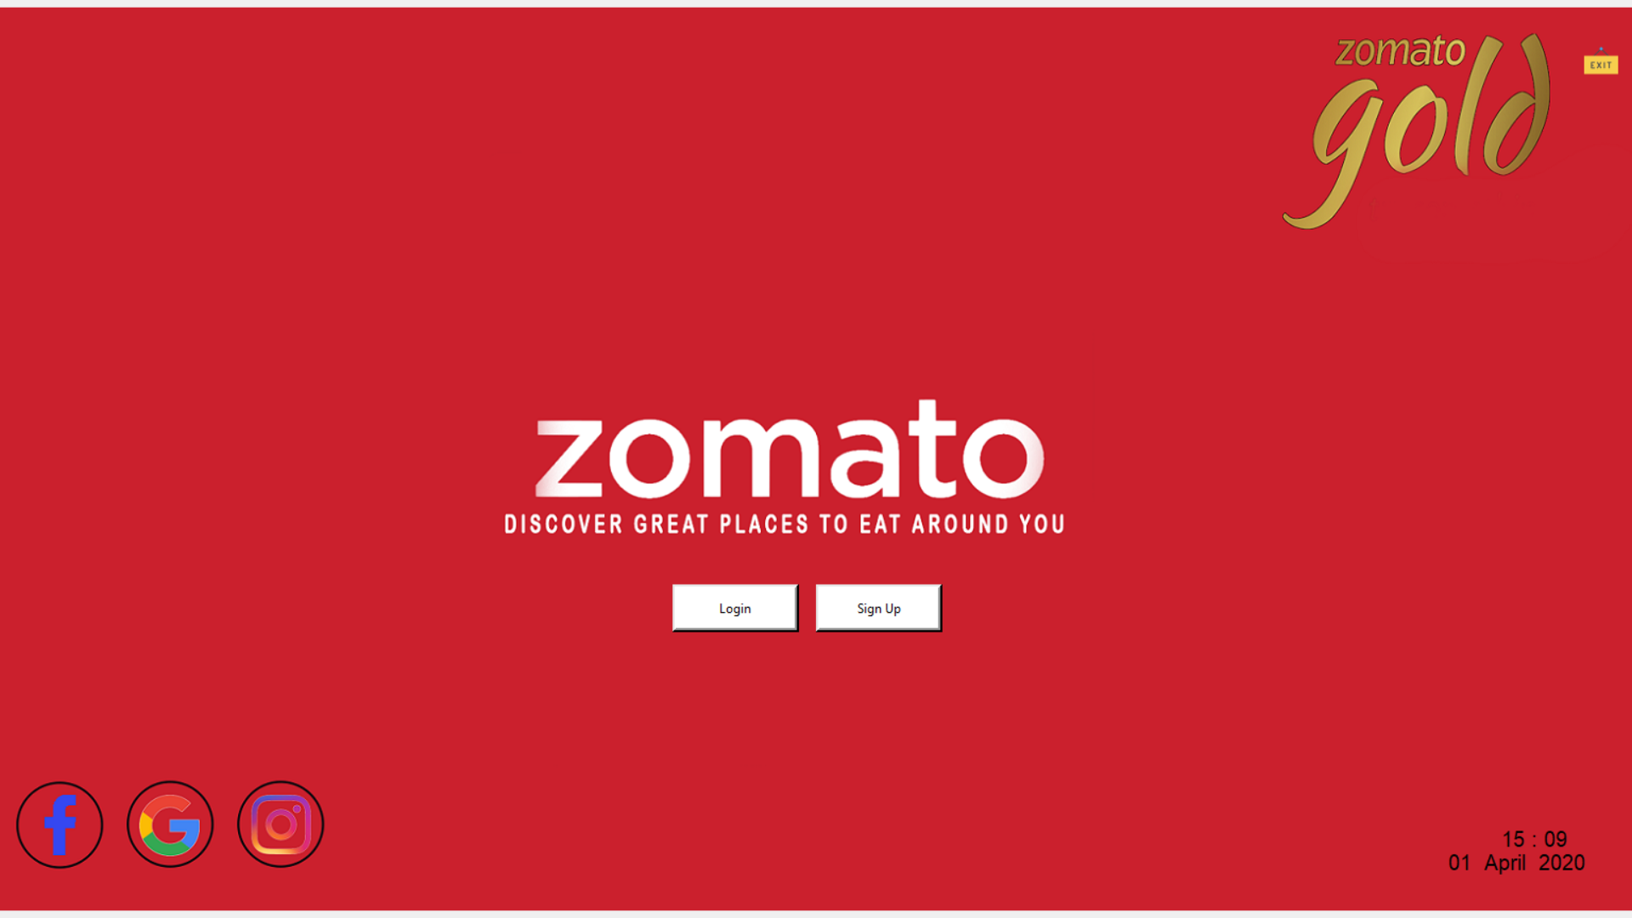
Main Page :
Exit :
Closes all the windows and shutdown the system.
Login Button :
For users who have signed up before.
Time :
System Current Time.
Signup Button :
For users who are new to this system and does not have a login.
Hyper-Link :
There are 3 hyperlinks to Facebook, Google and Instagram page of zomato (Official Handlers).

Slide 7
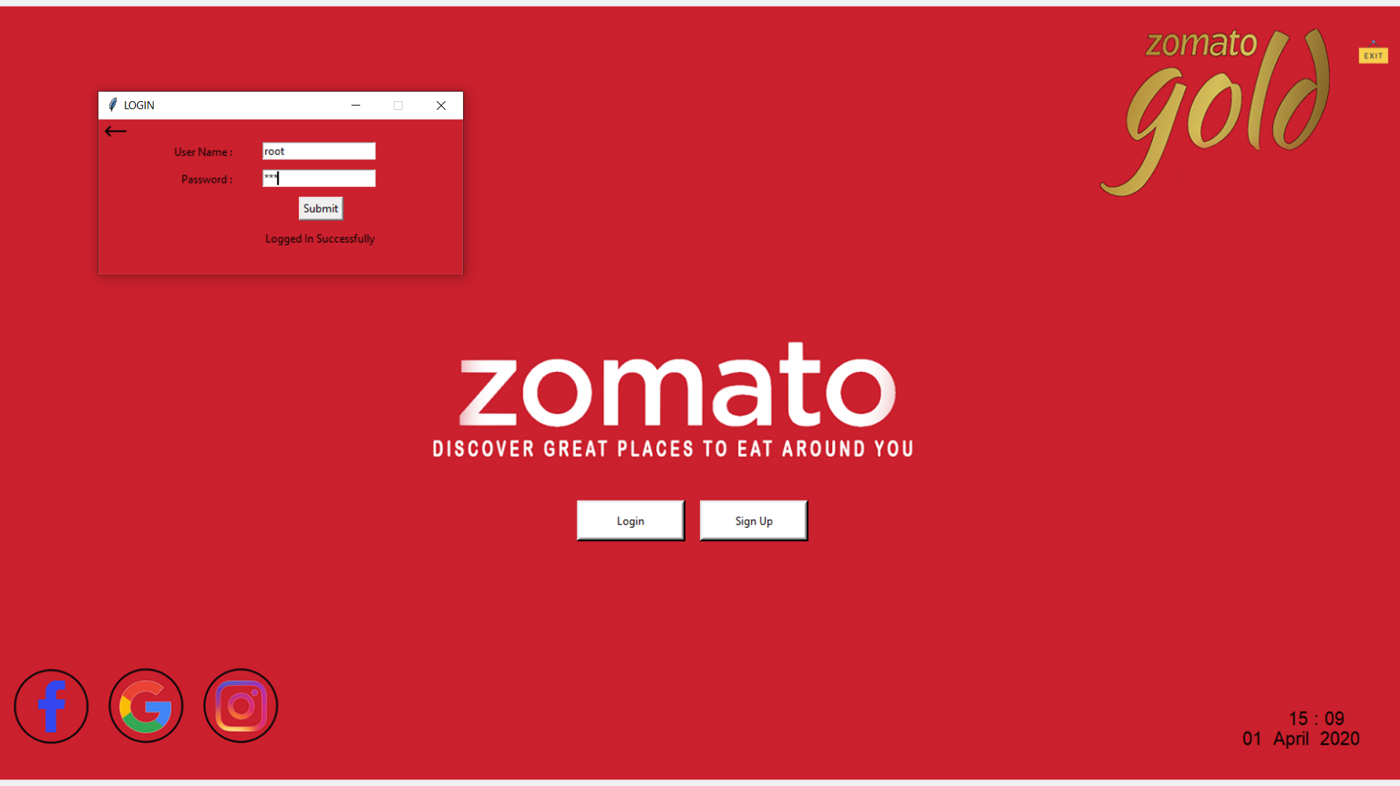

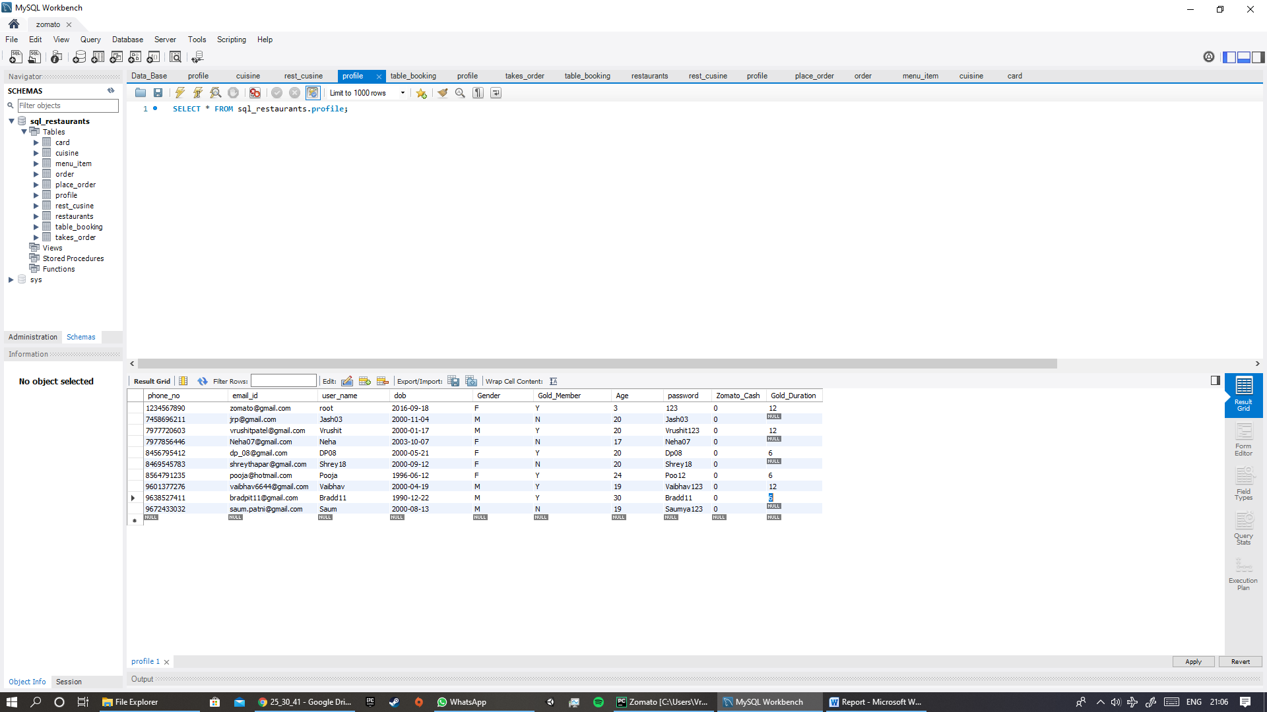
Login Page :
2 Entry Field :
To enter user name and password.
Back Button :
To go back to the main page.
Submit Button :
To submit the user name and password to check.
Label :
It will be printed if wrong credentials are entered
mycursor.execute("SELECT user_name,password FROM profile") username = mycursor.fetchall()
for u, p in username :
Then check if user name exist inside for loop , if yes then check its password.

Slide 8
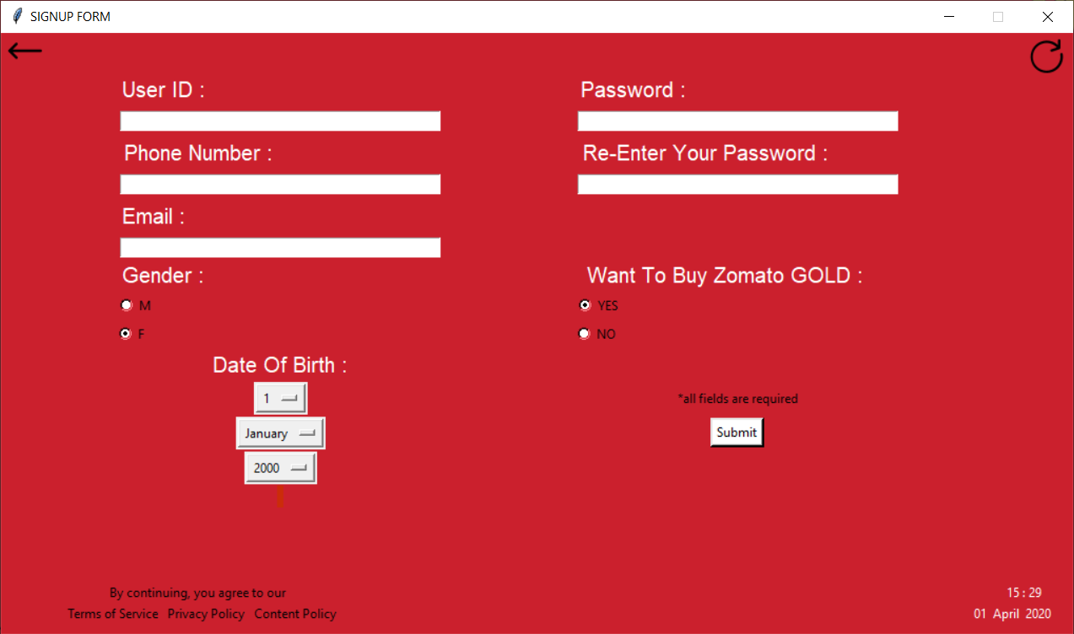
Sign-up Page :
5 Entry Field :
To collect data.
Back Button:
To go back to the main page.
Refresh Button :
To refresh the sign up page.
Submit Button :
To submit the user name and password to check.
Drop Down Menu :
For choosing –
Date of Birth
Month of Birth
Year of Birth
Radio Button :
For Being a zomato gold member.
For gender also.
Time :
System Current Time.

Slide 9
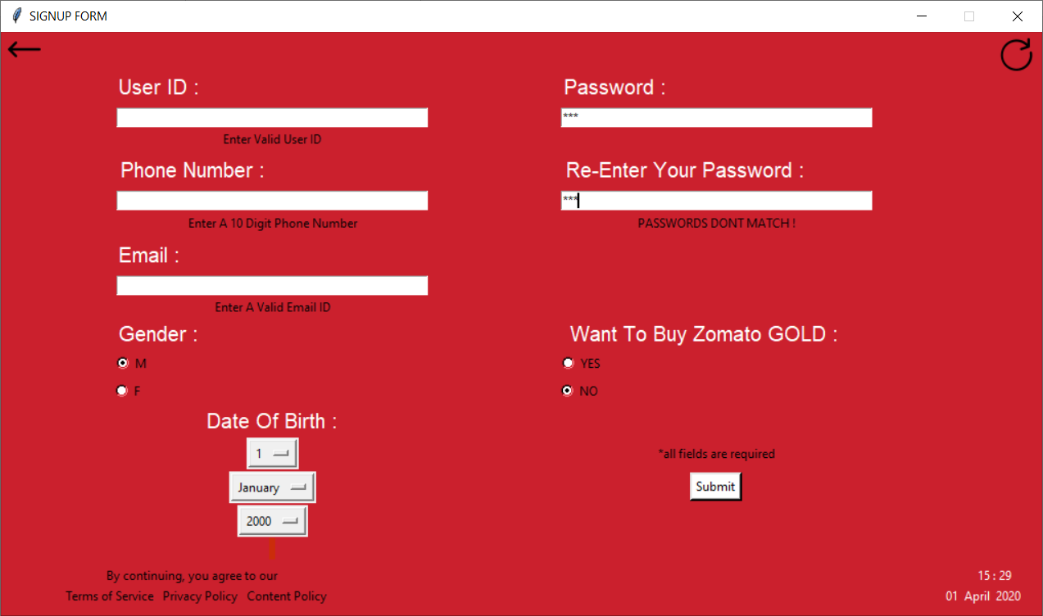
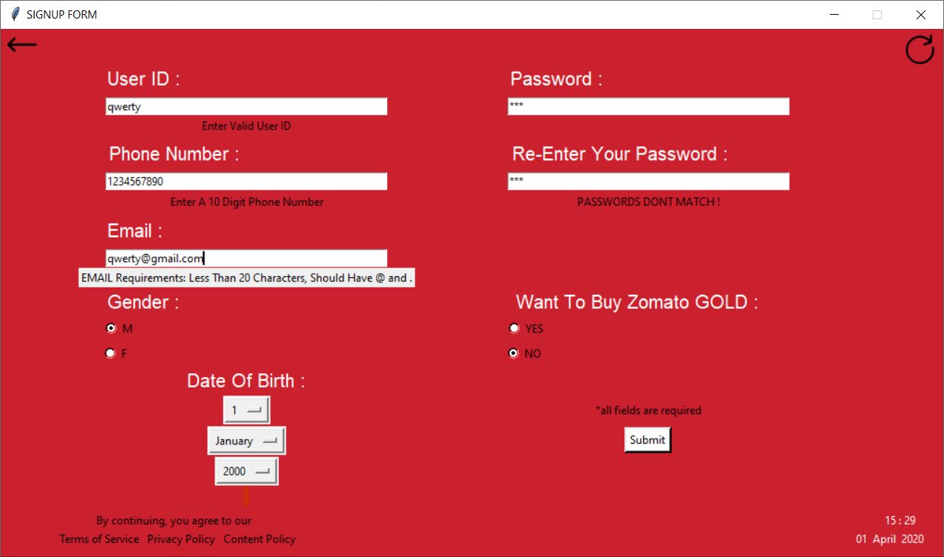
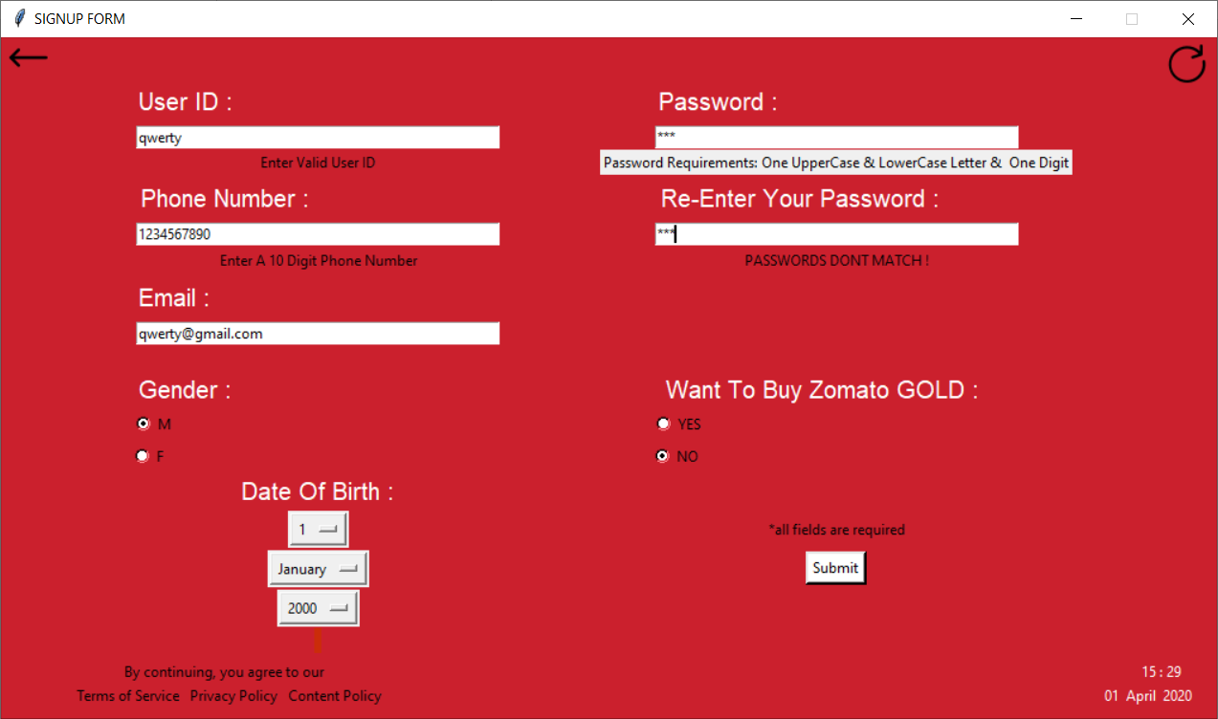
Sign-up Page :
Hovering :
Hovering is done on email and password to show some information.
Label :
It will be printed if password does not match.
mycursor.execute("Insert into profile() values(%s,%s,%s,%s,%s,%s,%s,%s,%s,%s)
ON DUPLICATE KEY UPDATE user_name=%s",
(phonenumber, emailid, user, dob1, gender1, gold1, age, p1,0,6,user))
mydb.commit()
It stores the data entered in the database : profile entity.

Slide 10
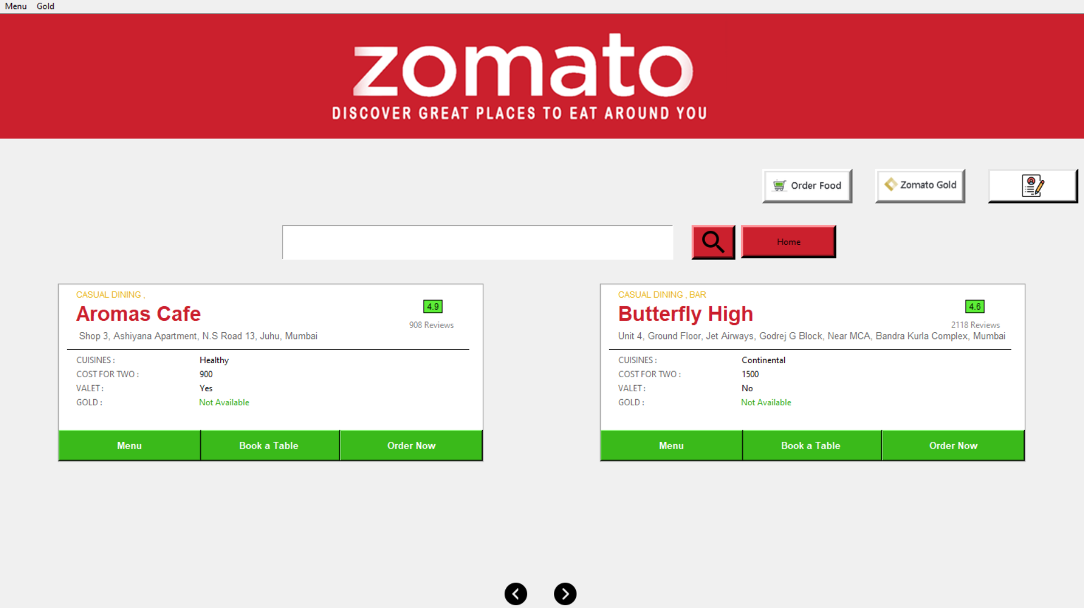
ZOMATO MAIN PAGE :
Order Food Button :
To view restaurants that provide online food delivery
Hovering is done on all 3 buttons
Gold Button :
To view restaurants only with zomato gold.
Entry Field:
To search a restaurant,
E.g.: Prithvi Cafe
Button :
A command to search the
entered
Restaurant.
Profile Button :
To view profile of the user logged in.
Canvas :
To print all the details of the restaurants .
Previous Button :
To see previous 2 restaurant canvas.
Next Button :
To see next 2 restaurant canvas.
It rotates all the restaurants in pair of 2 in a cyclic order

Slide 11
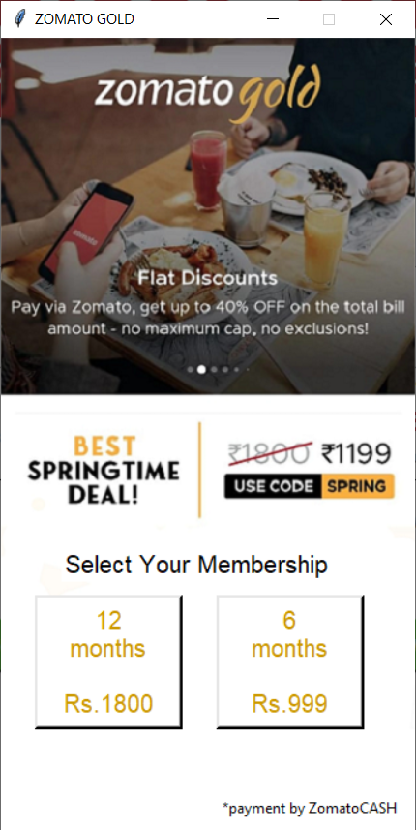
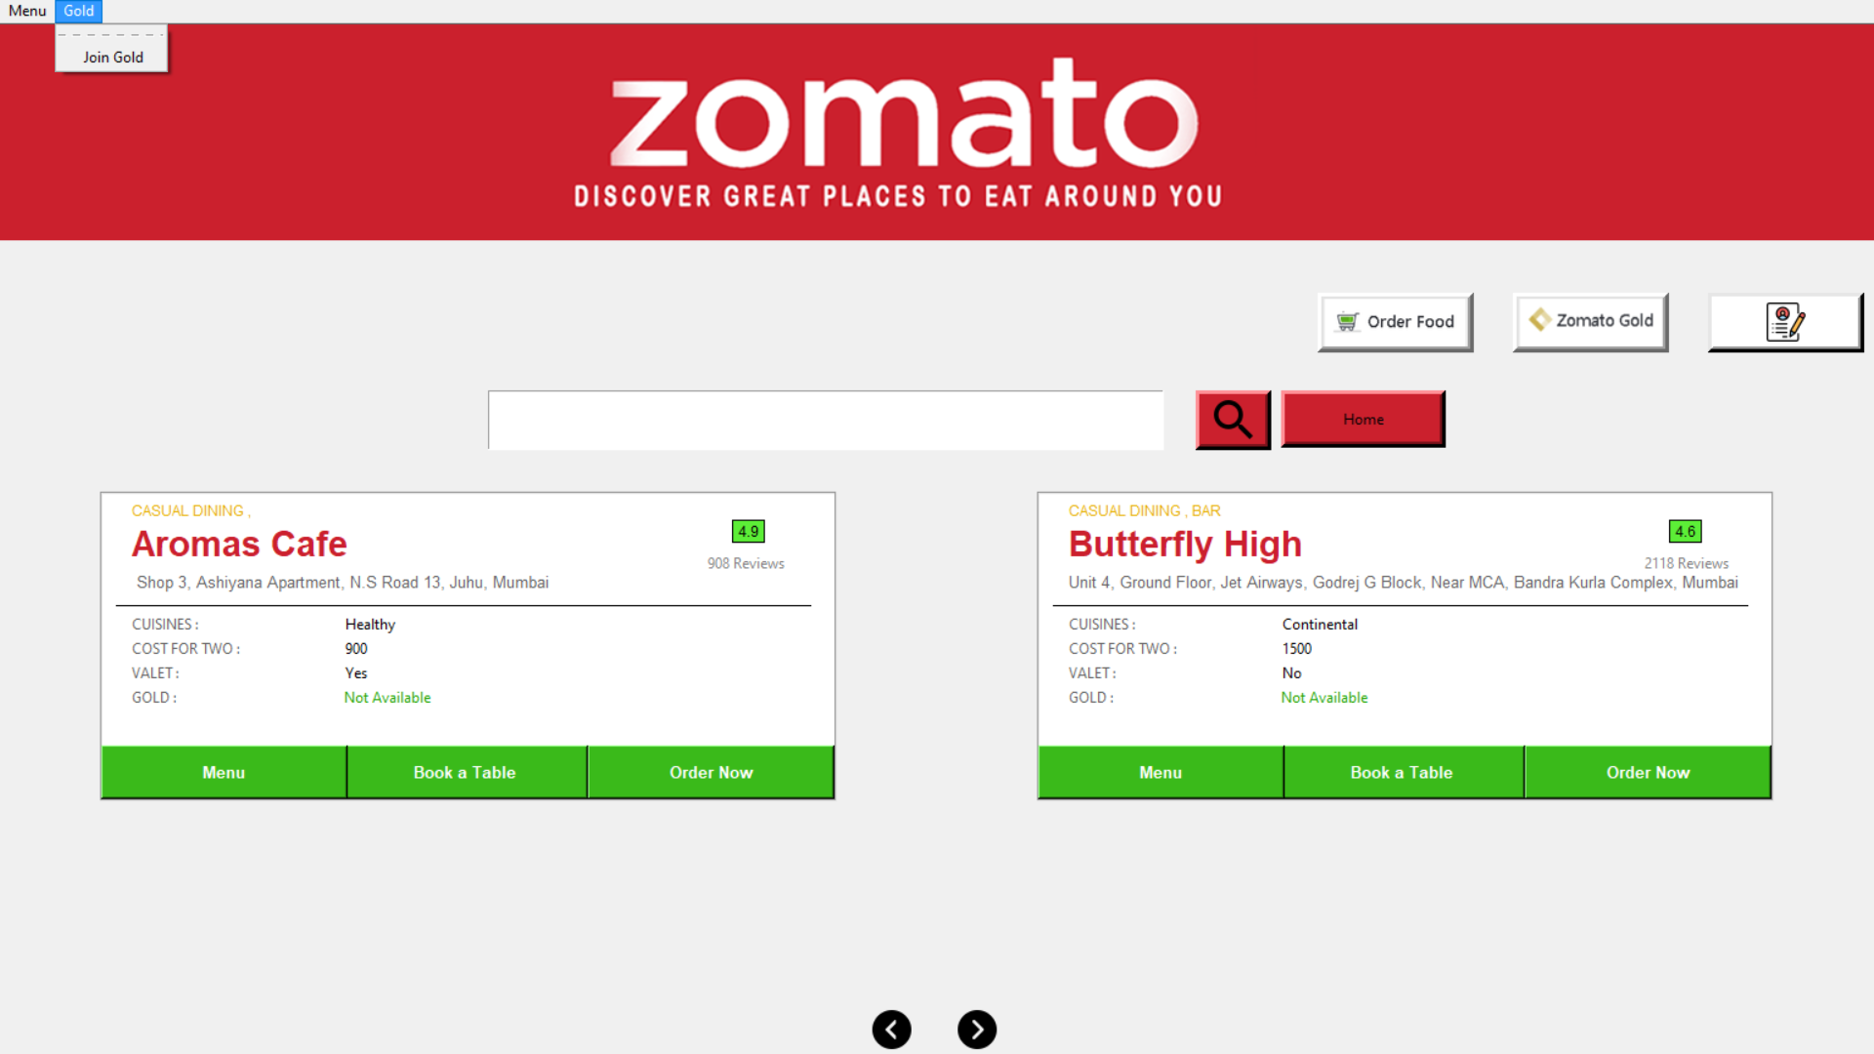
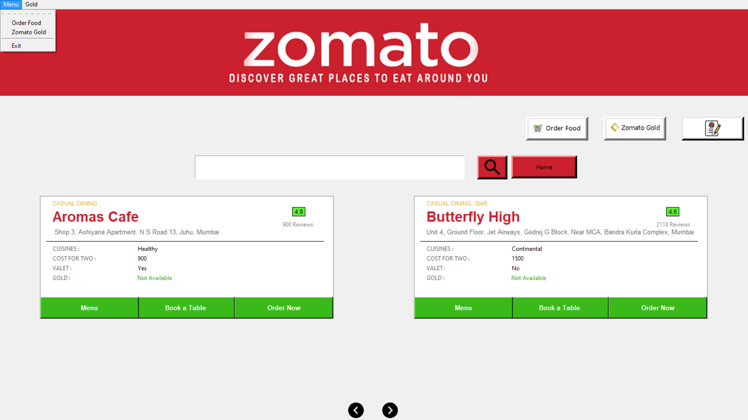
ZOMATO MAIN PAGE :
sql = "Update profile SET Gold_Member='Y',Gold_Duration='12' WHERE user_name = %s“
p = (user_id,) mycursor_p.execute(sql, p) mydb.commit()
Opens this page to become a gold member
Short-Cut Commands :
For :
Order Food
Zomato Gold
Exit

Slide 12

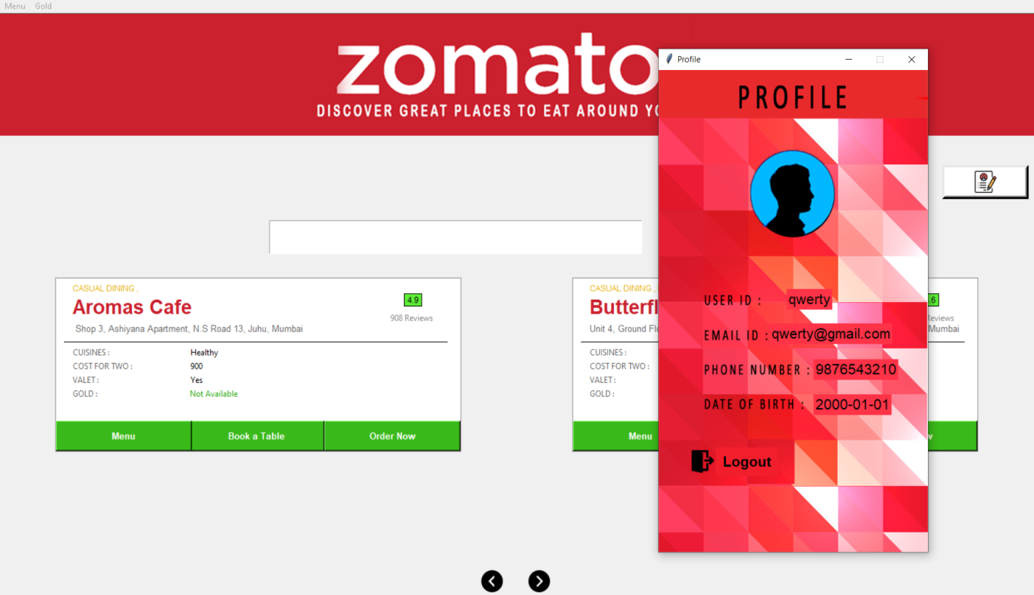
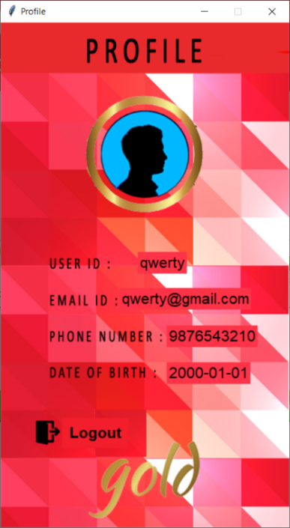
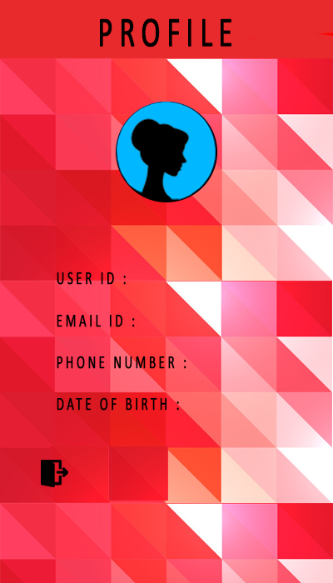
Profile Page :
sql = "SELECT * FROM profile WHERE user_name = %s" p = (user_id,) mycursor_p.execute(sql,p) details = mycursor_p.fetchall()
Prints all the details of the member logged in.
A male member before being a gold member.
A male member after being a gold member.
For a female member.
Logout Button to log out or exit.

Slide 13

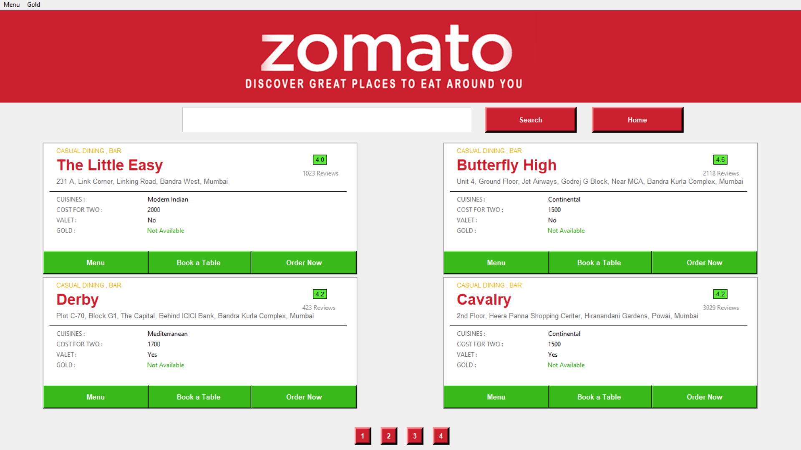
Order Food Page :
Home Button :
Takes you back to the Zomato main page.
Shows that restaurants that can take orders.
4 Buttons :
These buttons are pages, each page has 4 restaurants.
order_only = "Select * from restaurants where takes_order = 'Y'“
mycursor.execute(order_only) result = mycursor.fetchall()

Slide 14
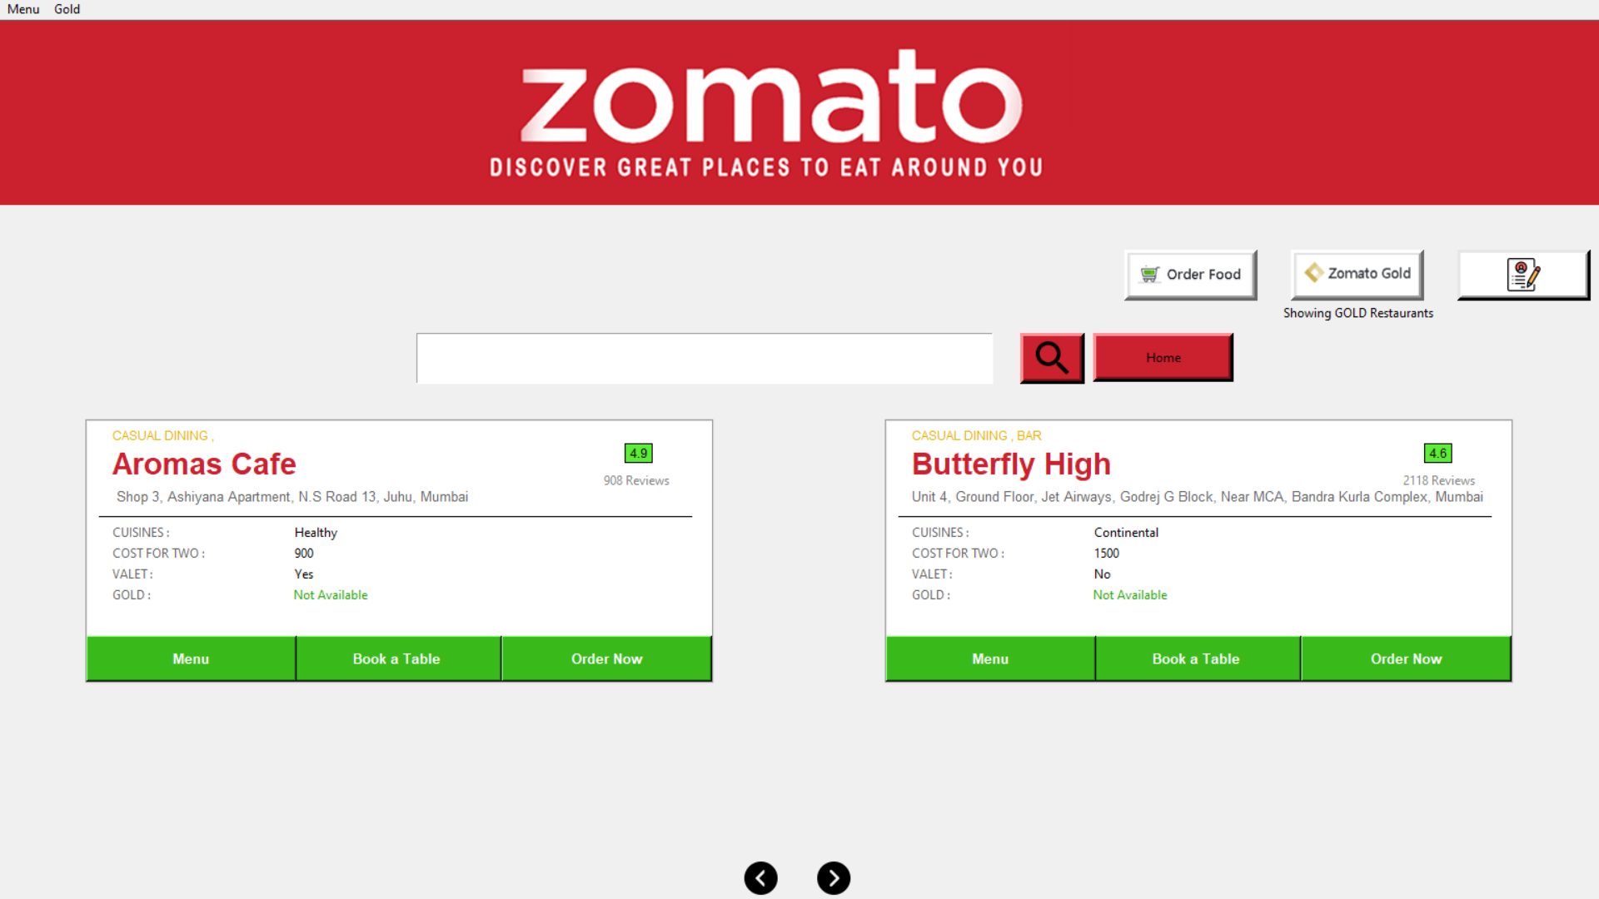
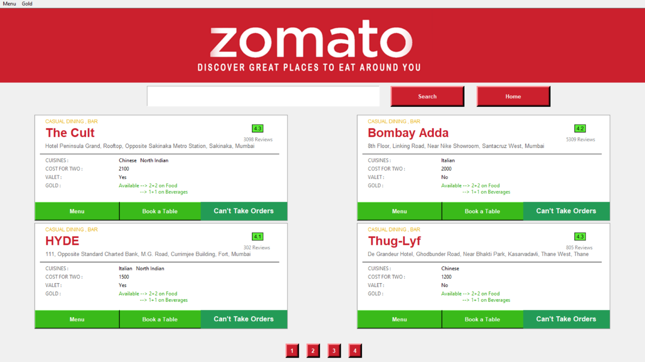
Zomato Gold Page :
Home Button :
Takes you back to the Zomato main page.
Shows that restaurants that have Zomato gold privileges.
4 Buttons :
These buttons are pages, each page has 4 restaurants.
gold_only = "Select * from restaurants where Gold = 'Y'“
mycursor.execute(gold_only) result = mycursor.fetchall()

Slide 15
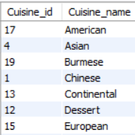
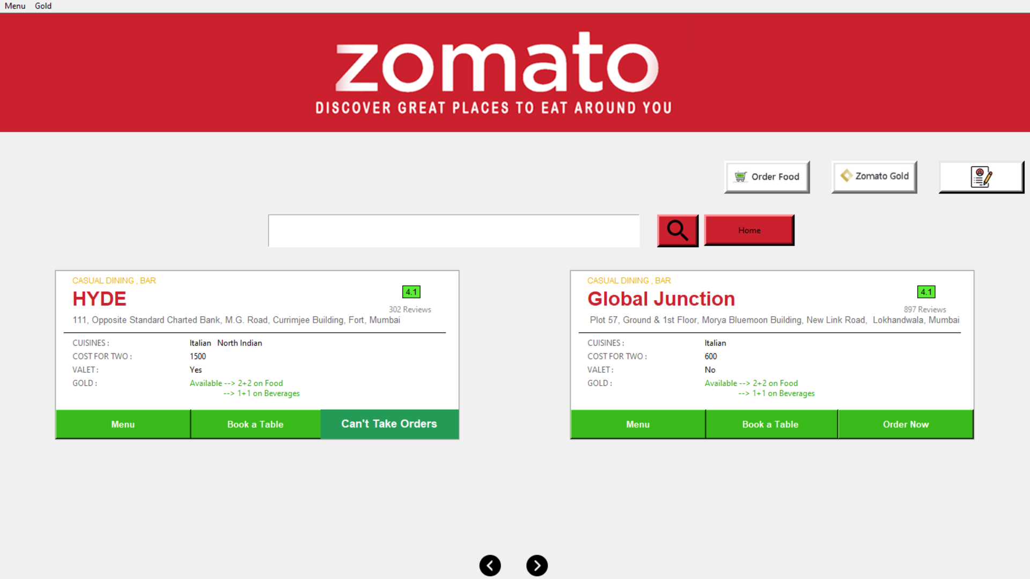
Restaurant Canvas :
Displays all the information in the form of labels from the database.
Cuisine is taken from this table →
rest = "SELECT * FROM restaurants Order By Rating desc" mycursor.execute(rest) result = mycursor.fetchall()
Menu Button :
Opens a page that shows the menu.
Book a Table Button :
Opens a page that books a table for that restaurant.
Order Now :
Opens a page that takes the order.

Slide 16
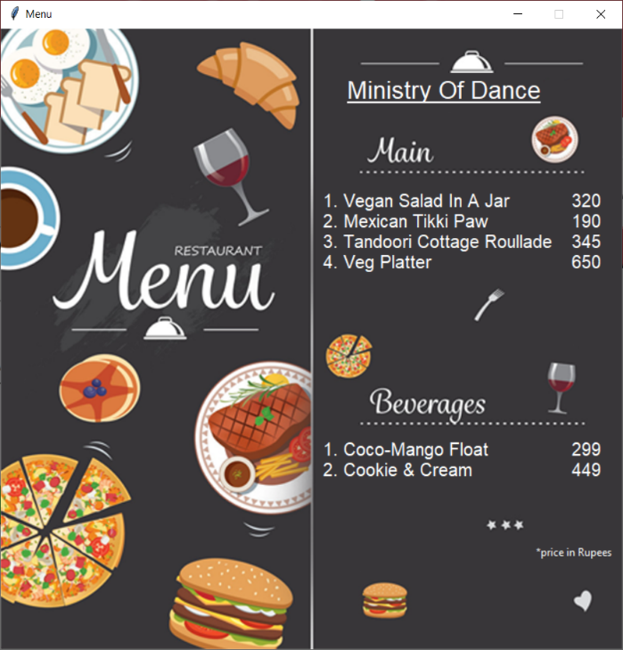
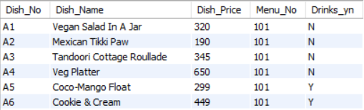
Menu of a Restaurant :
Displays all the details of the “Menu_Items” for a particular restaurant.
Menu_Items Entity
Extract each dish from the database and display’s its information above in the page as labels
mycursor_r = mydb.cursor() sql = "SELECT * FROM menu_item WHERE Menu_No = %s" r = (menu_no,) mycursor_r.execute(sql, r) details = mycursor_r.fetchall()

Slide 17
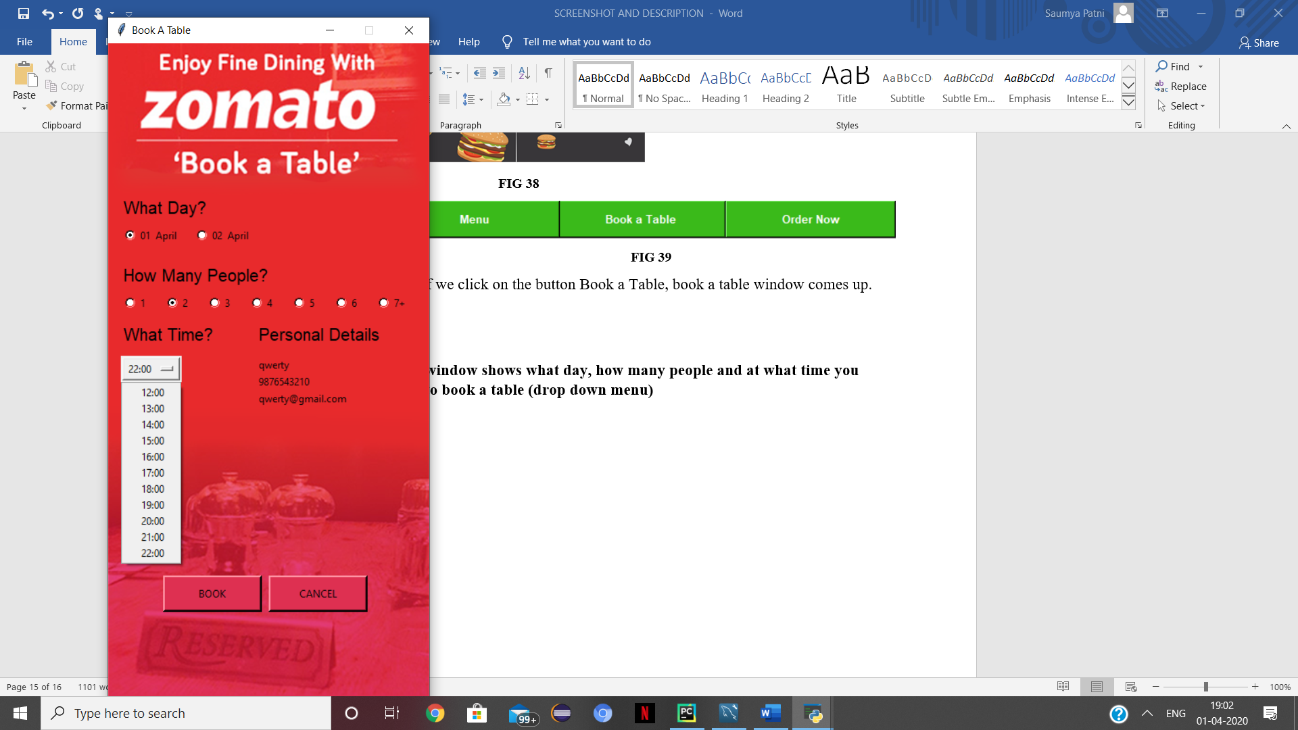
Book a Table for a Restaurant :
Radio Button :
To choose a day of booking.
Radio Button :
To choose size of the table.
Label :
To display all the details of the member booking the table..
Drop Down
Menu :
To choose suitable
time for your meal.
insert = "Insert into table_booking(
Date,phone_no,email_id,No_person,Time,name) values
(%s,%s,%s,%s,%s,%s)“
cuisine1 = [(da_te,phno,mailid,np,ti_me,name_text),]
mycursor_p.executemany(insert, cuisine1) mydb.commit()
Book Button :
Confirms your booking and inserts the information in the database.
Cancel Button :
Cancels the booking and destroys the window.

Slide 18
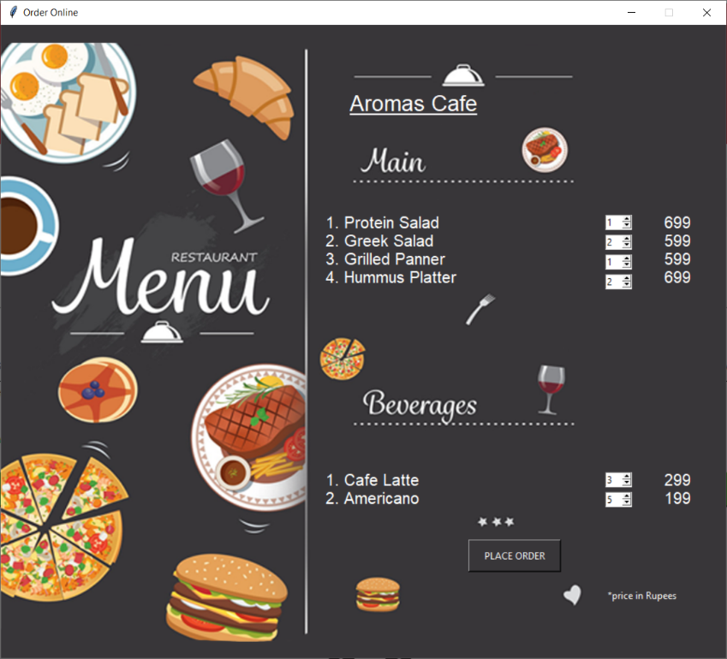
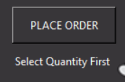
Order Food for a Restaurant :
Displays all the details of the “Menu_Items” for a particular restaurant.
Spin Button :
To select number of dishes you want.
If all the spin buttons are zero i.e. no dish's selected then it will not move further and print this Label.
Place Order Button :
Confirms your order and goes to the Bill page.

Slide 19
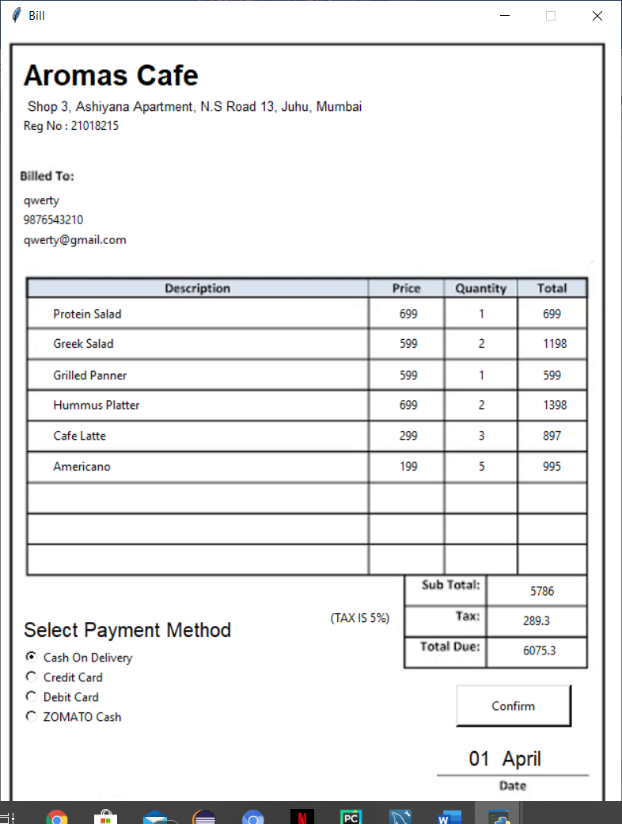
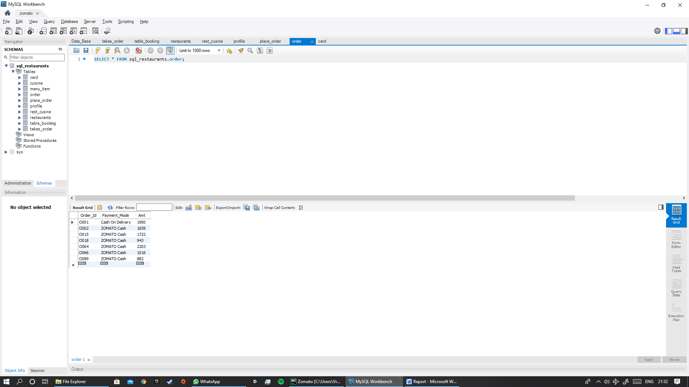
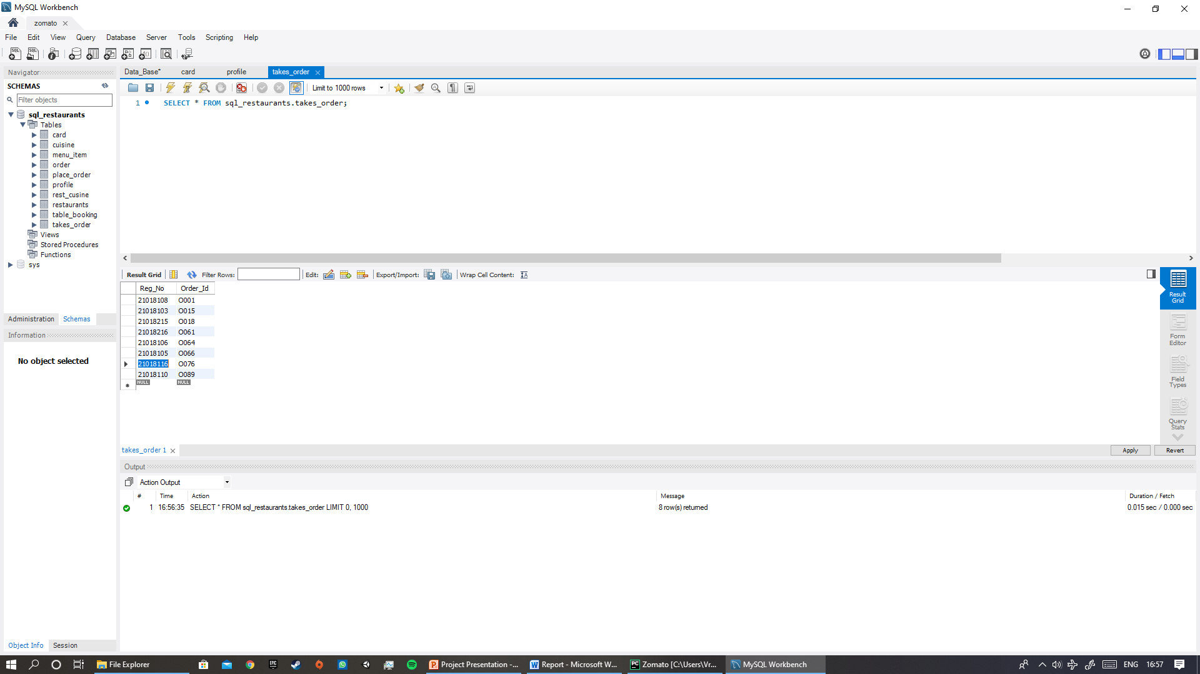
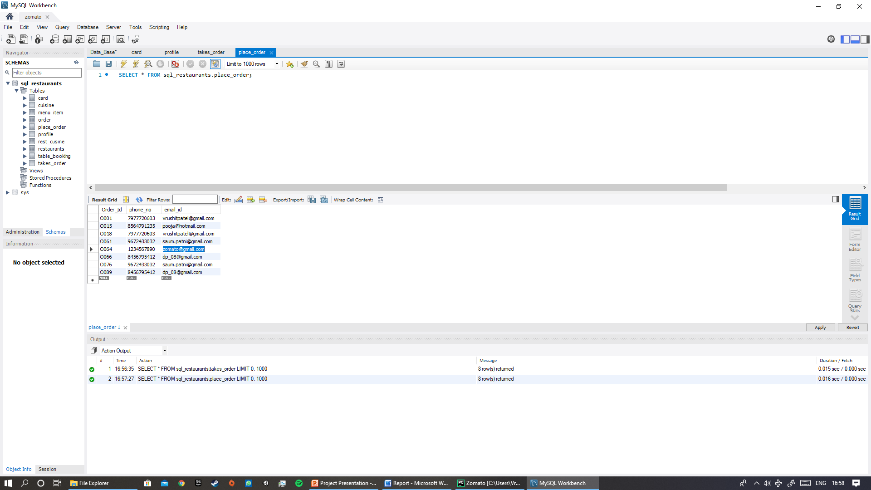
Bill Page :
It prints the restaurant details.
Prints all dishes selected by the customer with its price. Calculate the final amount to be paid.
It prints the member details.
Confirm Button :
Confirms your order and inserts into the database.
Radio Button :
To select payment method .
mycursor.execute("INSERT INTO order values (%s,%s,%s);",val1) mycursor.execute("INSERT INTO takes_order values (%s,%s);", val2) mycursor.execute("INSERT INTO place_order values (%s,%s,%s);", val3) mydb.commit()

Slide 20
Conclusion :
After successful completion of the report we as a group are able to -
Explain the basics of ER diagram & its importance in database design.
Design ER diagram for our project.
Convert the ER diagram into equivalent relational model.
Learnt how to make a schema diag.
Apply knowledge of relational algebra & structural query language to retrieve & manage data in relational dbs.
Understand & develop GUI using Tkinter in Python
Understand & develop programs using dbs.

